Slide 1
Lecture 4 3D Modeling and Animation Assoc.Prof.Dr. Hossam Mahmoud Moftah Associate professor – Faculty of computers and artificial intelligence– Beni-Suef University

Slide 2
Chapter 4 Exploring Animation, Story, and Pre-visualization
Adapted from Andy Beane: 3D animation essentials 2012 by John Wiley & Sons, Inc.,

Slide 3
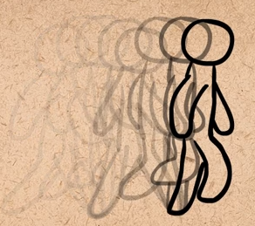
Visual arts in Character Animation
Straight-Ahead Action and Pose-to-Pose
Straight-ahead action and pose-to-pose are two techniques used in traditional animation that help the animator in knowing how to approach a shot.
Straight Ahead
Animator start from first drawing in the scene and draw all subsequent frames until the end of scene.
Adapted from AlanBecker Tutorials- The 12 principles of animation by Frank Thomas & Ollie Johnston
Adapted from Andy Beane: 3D animation essentials 2012 by John Wiley & Sons, Inc.,

Slide 4
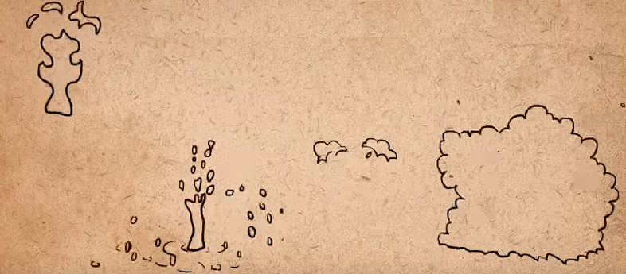
Visual arts in Character Animation
When using Straight-Ahead ?
In unpredictable actions
Actions depend on physics that work in a constant rate
Examples: fire, water particles, dust, and explosions
Adapted from AlanBecker Tutorials- The 12 principles of animation by Frank Thomas & Ollie Johnston
Adapted from Andy Beane: 3D animation essentials 2012 by John Wiley & Sons, Inc.,

Slide 5
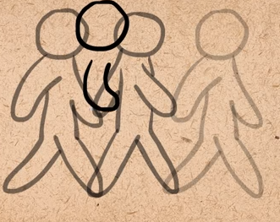
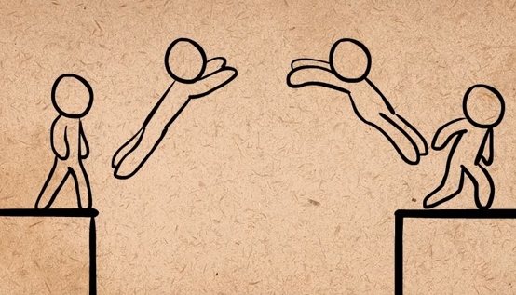
Visual arts in Character Animation
Pose-to-Pose
is a technique of drawing out the key poses of an action first and then in-betweening the action between the key poses.
Adapted from AlanBecker Tutorials- The 12 principles of animation by Frank Thomas & Ollie Johnston
Adapted from Andy Beane: 3D animation essentials 2012 by John Wiley & Sons, Inc.,

Slide 6
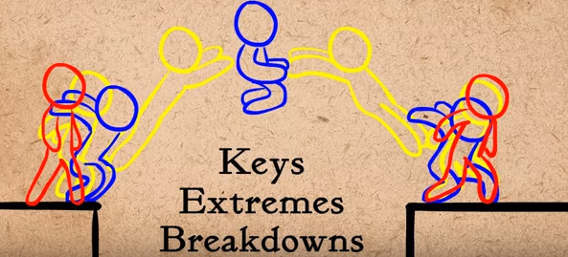

Visual arts in Character Animation
Pose-to-Pose
Adapted from AlanBecker Tutorials- The 12 principles of animation by Frank Thomas & Ollie Johnston
Adapted from Andy Beane: 3D animation essentials 2012 by John Wiley & Sons, Inc.,

Slide 7
Visual arts in Character Animation
Follow-Through and Overlapping Action
Follow-through enables animators to show that parts of an object may continue moving even after the whole object has stopped
For instance, when a character who has long hair has stopped walking, the hair will overshoot the body/head and then settle to a stop.
Overlapping action applies to a character’s body parts, which move at different rates of speed while the entire body is moving.
This can be seen in a fat character’s belly jiggle, for example, which may move faster or slower than the character as a whole.
Adapted from Andy Beane: 3D animation essentials 2012 by John Wiley & Sons, Inc.,

Slide 8
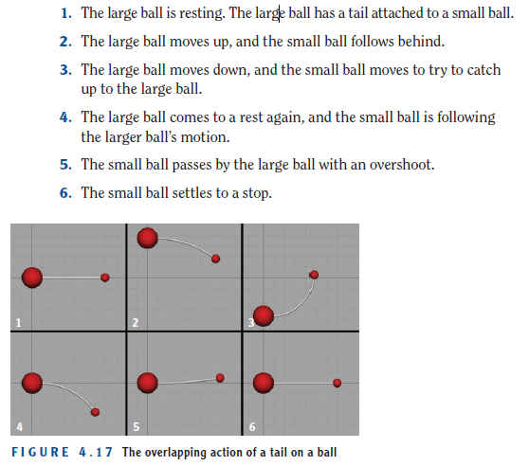
Visual arts in Character Animation
Follow-Through and Overlapping Action
Adapted from Andy Beane: 3D animation essentials 2012 by John Wiley & Sons, Inc.,

Slide 9
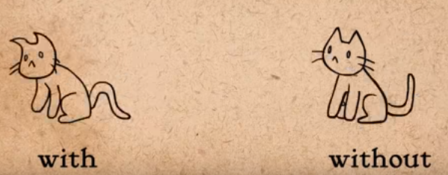
Visual arts in Character Animation
Follow-Through and Overlapping Action
Follow-Through
Follow-Through
Adapted from AlanBecker Tutorials- The 12 principles of animation by Frank Thomas & Ollie Johnston
Adapted from Andy Beane: 3D animation essentials 2012 by John Wiley & Sons, Inc.,

Slide 10
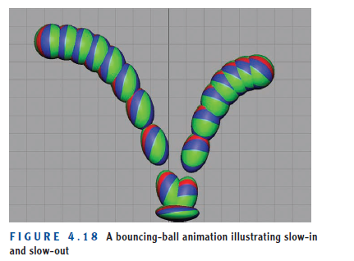
Visual arts in Character Animation
Slow-In and Slow-Out
Slow-in and slow-out (also known as ease-in and ease-out) describes the acceleration and deceleration required when an object starts moving or comes to a stop.
A good example of these principles is a car drag race.
Adapted from Andy Beane: 3D animation essentials 2012 by John Wiley & Sons, Inc.,

Slide 11
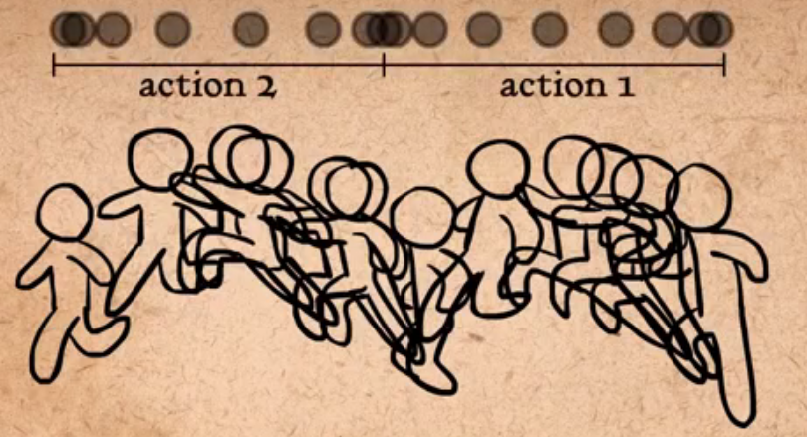
Visual arts in Character Animation
Slow-In and Slow-Out
Adapted from AlanBecker Tutorials- The 12 principles of animation by Frank Thomas & Ollie Johnston
Adapted from Andy Beane: 3D animation essentials 2012 by John Wiley & Sons, Inc.,

Slide 12
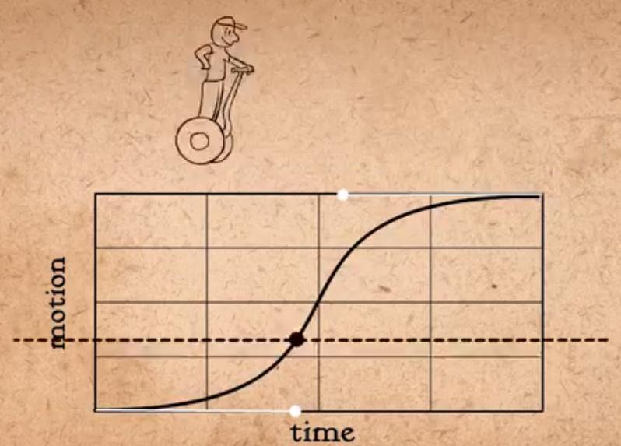
Visual arts in Character Animation
Slow-In and Slow-Out
Using linear spline In 3D animation
Adapted from AlanBecker Tutorials- The 12 principles of animation by Frank Thomas & Ollie Johnston
Adapted from Andy Beane: 3D animation essentials 2012 by John Wiley & Sons, Inc.,

Slide 13
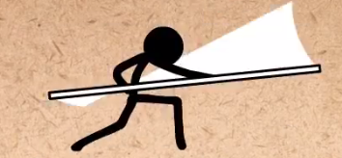
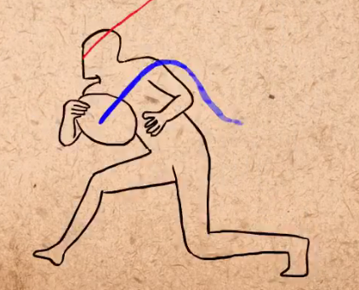
Visual arts in Character Animation
Arcs
Most objects move in arcs. Your arms and legs, for instance, rotate around their joints (these rotational points are called pivot points in 3D animation).
Adapted from AlanBecker Tutorials- The 12 principles of animation by Frank Thomas & Ollie Johnston
Adapted from Andy Beane: 3D animation essentials 2012 by John Wiley & Sons, Inc.,

Slide 14
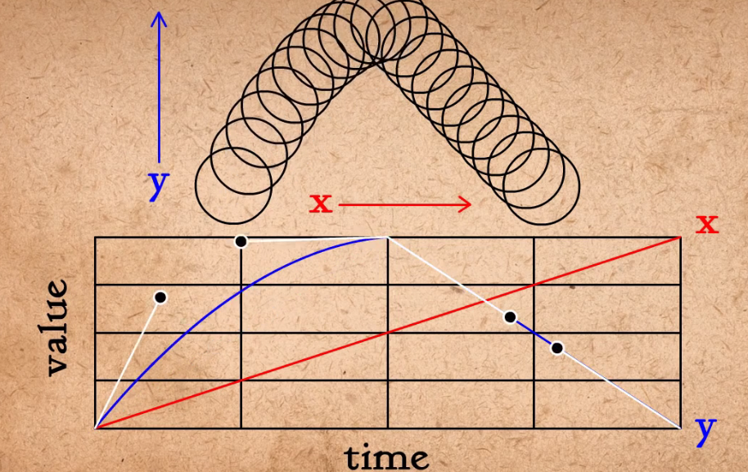
Visual arts in Character Animation
Arcs
Adapted from AlanBecker Tutorials- The 12 principles of animation by Frank Thomas & Ollie Johnston
Adapted from Andy Beane: 3D animation essentials 2012 by John Wiley & Sons, Inc.,

Slide 15
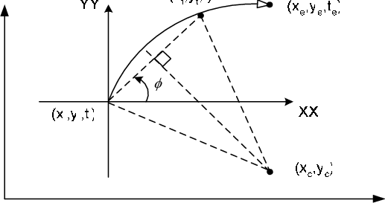
Visual arts in Character Animation
Arcs
value
time

Slide 16
Visual arts in Character Animation
Secondary Action
Secondary action supports the primary action.
For example, say that you are animating a man crying to a friend and explaining that his son has injured.
The primary action of this scene is the crying and explaining.
You could add a secondary action—the man wiping his nose or reaching into a bag to get a tissue to wipe his eyes—to support the primary action of the scene.
Adapted from Andy Beane: 3D animation essentials 2012 by John Wiley & Sons, Inc.,

Slide 17
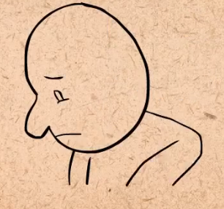
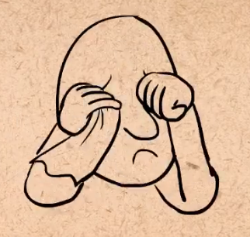
Visual arts in Character Animation
Secondary Action
without
with
Adapted from AlanBecker Tutorials- The 12 principles of animation by Frank Thomas & Ollie Johnston
Adapted from Andy Beane: 3D animation essentials 2012 by John Wiley & Sons, Inc.,

Slide 18
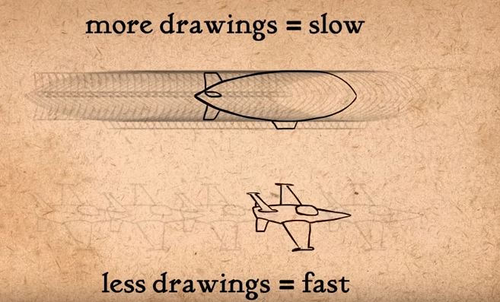
Visual arts in Character Animation
Timing
Timing is how long it takes to do something. As an animator, you will be typically working in 24, 25, or 30 frames per second, depending on the format used for output.
The standard is 24 fps
Adapted from AlanBecker Tutorials- The 12 principles of animation by Frank Thomas & Ollie Johnston
Adapted from Andy Beane: 3D animation essentials 2012 by John Wiley & Sons, Inc.,

Slide 19
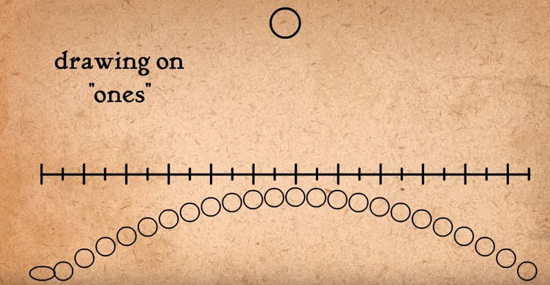
Visual arts in Character Animation
Timing
Adapted from AlanBecker Tutorials- The 12 principles of animation by Frank Thomas & Ollie Johnston
Adapted from Andy Beane: 3D animation essentials 2012 by John Wiley & Sons, Inc.,

Slide 20
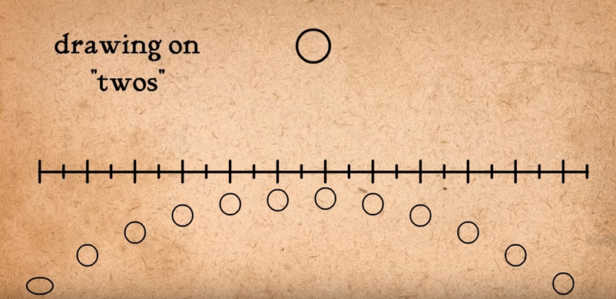
Visual arts in Character Animation
Timing
Adapted from AlanBecker Tutorials- The 12 principles of animation by Frank Thomas & Ollie Johnston
Adapted from Andy Beane: 3D animation essentials 2012 by John Wiley & Sons, Inc.,

Slide 21
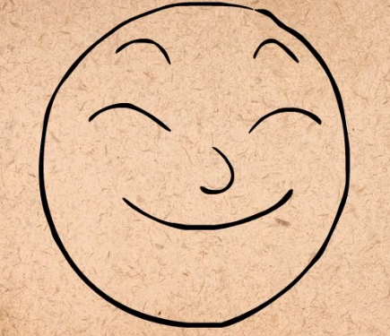
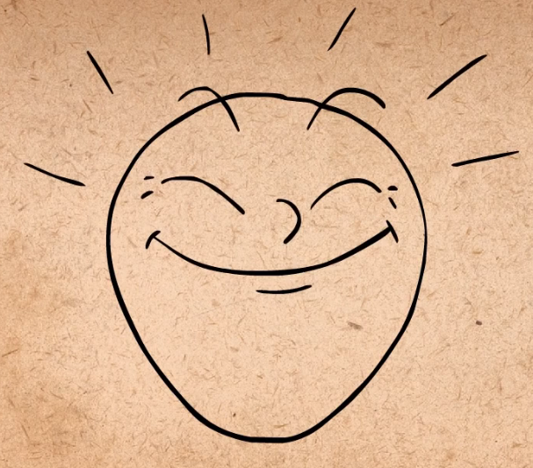
Visual arts in Character Animation
Exaggeration
Exaggeration is a tool to make animation more extreme.
For example, motion capture is used to record and translate the motion of a real person onto a 3D character.
bright
brighter
Adapted from AlanBecker Tutorials- The 12 principles of animation by Frank Thomas & Ollie Johnston
Adapted from Andy Beane: 3D animation essentials 2012 by John Wiley & Sons, Inc.,

Slide 22
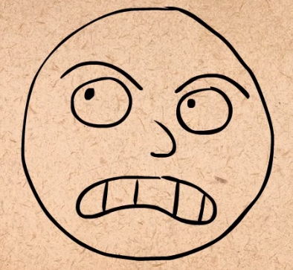
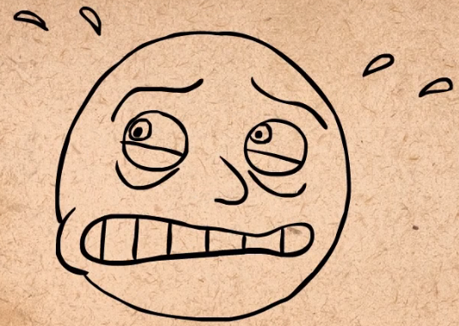
Visual arts in Character Animation
Exaggeration
worried
More worried
Adapted from AlanBecker Tutorials- The 12 principles of animation by Frank Thomas & Ollie Johnston
Adapted from Andy Beane: 3D animation essentials 2012 by John Wiley & Sons, Inc.,

Slide 23
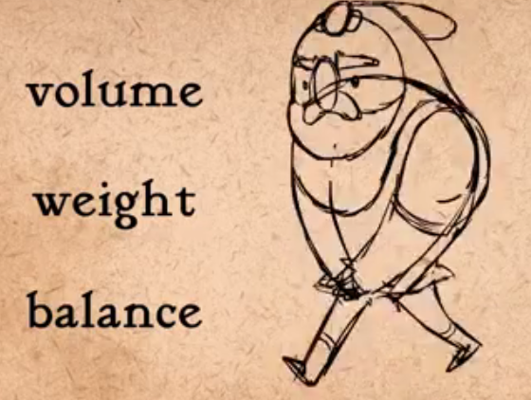
Visual arts in Character Animation
Solid Drawing
Solid drawing (also now known as knowledge of software) is the understanding of basic and technical concepts to allow the artist to focus on the art.
Three things must be considered when drwaing character: Volume, weight, balance.
Adapted from AlanBecker Tutorials- The 12 principles of animation by Frank Thomas & Ollie Johnston
Adapted from Andy Beane: 3D animation essentials 2012 by John Wiley & Sons, Inc.,

Slide 24
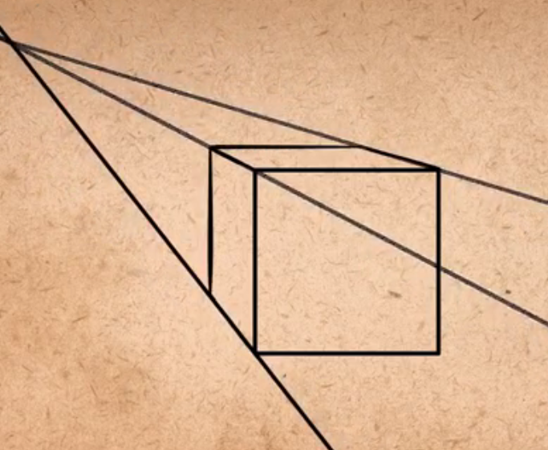
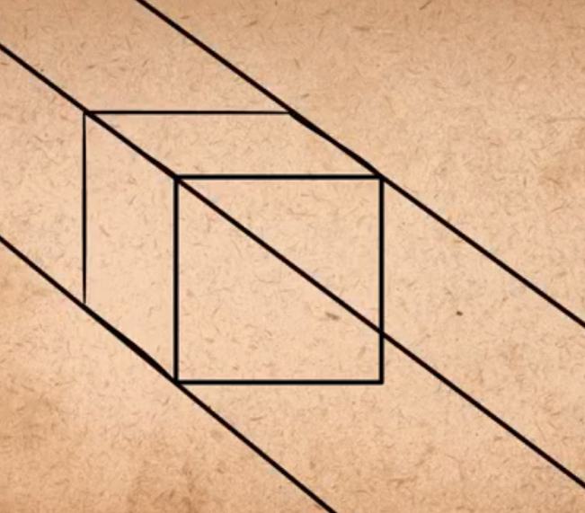
Visual arts in Character Animation
Solid Drawing
When drawing cubes avoid making parallel lines,
Lines should be drawn using vanishing points
wrong
Correct
Adapted from AlanBecker Tutorials- The 12 principles of animation by Frank Thomas & Ollie Johnston
Adapted from Andy Beane: 3D animation essentials 2012 by John Wiley & Sons, Inc.,

Slide 25
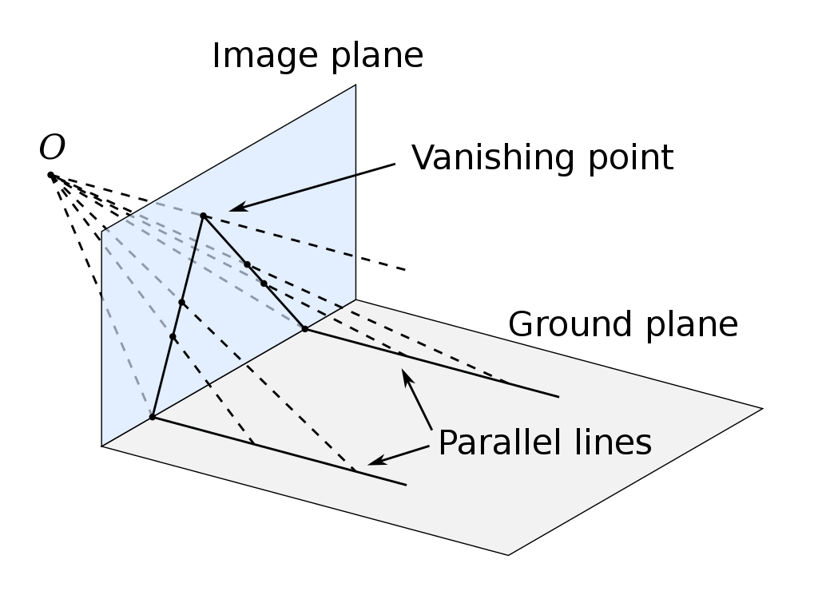
Visual arts in Character Animation
Solid Drawing
A vanishing point is a point on the image plane of a perspective drawing where the two-dimensional perspective projections (or drawings) of mutually parallel lines in three-dimensional space appear to converge.

Slide 26
Visual arts in Character Animation
Appeal
Appeal is a principle indicating that the audience must connect to a character through its personality.
Appeal steps:
Use variety of shapes
Play with proportions
Keep it simple
Adapted from AlanBecker Tutorials- principles by Frank Thomas & Ollie Johnston
Adapted from Andy Beane: 3D animation essentials 2012 by John Wiley & Sons, Inc.,

Slide 27
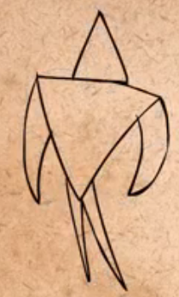
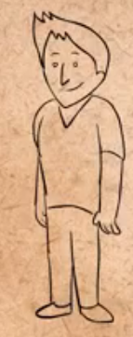
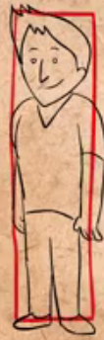
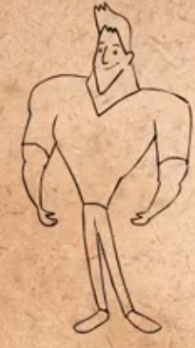
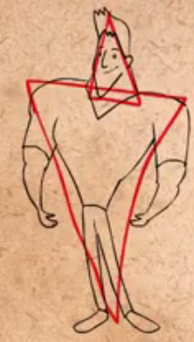
Visual arts in Character Animation
Appeal
Use variety of shapes
Shape 1
Adapted from AlanBecker Tutorials- The 12 principles of animation by Frank Thomas & Ollie Johnston
Adapted from Andy Beane: 3D animation essentials 2012 by John Wiley & Sons, Inc.,

Slide 28
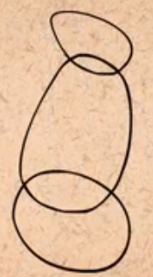
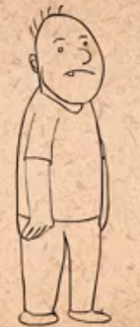
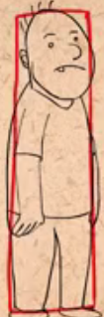
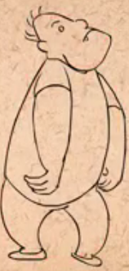
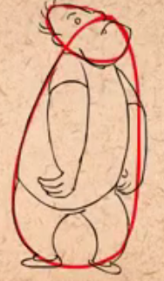
Visual arts in Character Animation
Appeal
Use variety of shapes
Shape 2
Adapted from AlanBecker Tutorials- The 12 principles of animation by Frank Thomas & Ollie Johnston
Adapted from Andy Beane: 3D animation essentials 2012 by John Wiley & Sons, Inc.,

Slide 29
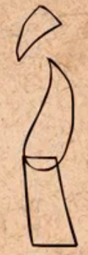
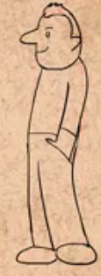
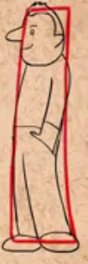
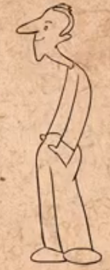
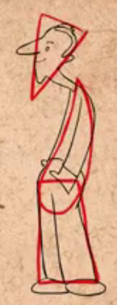
Visual arts in Character Animation
Appeal
Use variety of shapes
Shape 3
Adapted from AlanBecker Tutorials- The 12 principles of animation by Frank Thomas & Ollie Johnston
Adapted from Andy Beane: 3D animation essentials 2012 by John Wiley & Sons, Inc.,

Slide 30
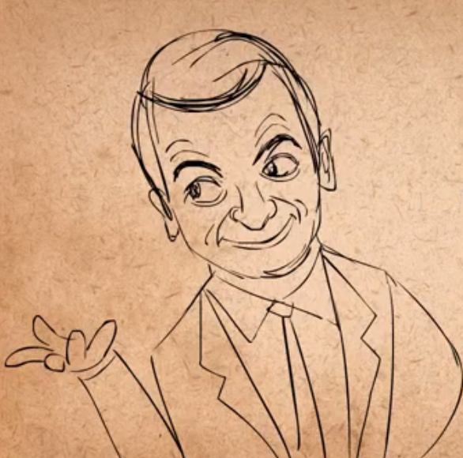
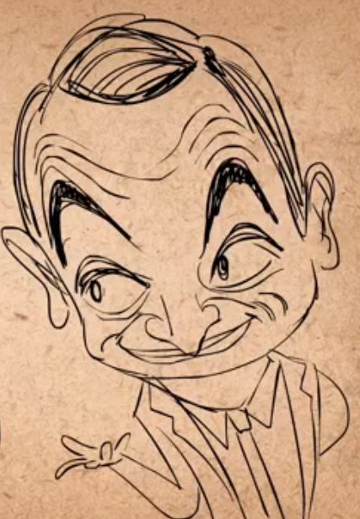
Visual arts in Character Animation
Appeal
2. Play with proportions
Adapted from AlanBecker Tutorials- The 12 principles of animation by Frank Thomas & Ollie Johnston
Adapted from Andy Beane: 3D animation essentials 2012 by John Wiley & Sons, Inc.,

Slide 31
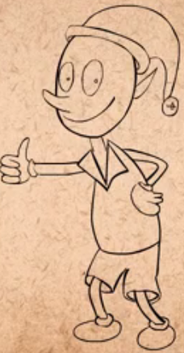
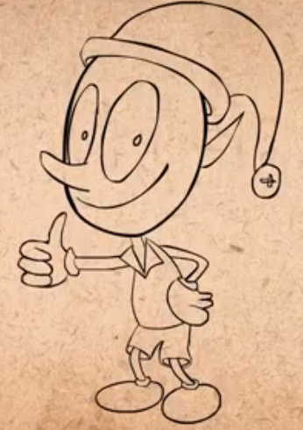
Visual arts in Character Animation
Appeal
2. Play with proportions
Adapted from AlanBecker Tutorials- The 12 principles of animation by Frank Thomas & Ollie Johnston
Adapted from Andy Beane: 3D animation essentials 2012 by John Wiley & Sons, Inc.,

Slide 32
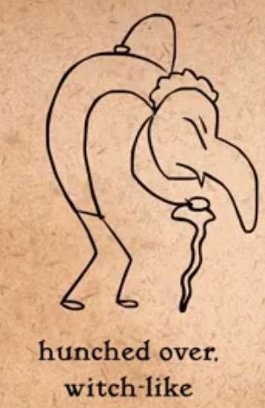
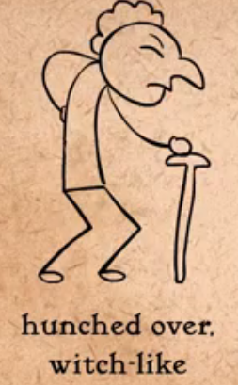
Visual arts in Character Animation
Appeal
2. Play with proportions
Adapted from AlanBecker Tutorials- The 12 principles of animation by Frank Thomas & Ollie Johnston
Adapted from Andy Beane: 3D animation essentials 2012 by John Wiley & Sons, Inc.,

Slide 33
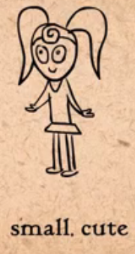
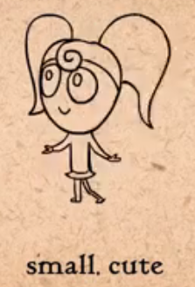
Visual arts in Character Animation
Appeal
2. Play with proportions
Adapted from AlanBecker Tutorials- The 12 principles of animation by Frank Thomas & Ollie Johnston
Adapted from Andy Beane: 3D animation essentials 2012 by John Wiley & Sons, Inc.,

Slide 34


Visual arts in Character Animation
Appeal
2. Play with proportions
Adapted from AlanBecker Tutorials- The 12 principles of animation by Frank Thomas & Ollie Johnston
Adapted from Andy Beane: 3D animation essentials 2012 by John Wiley & Sons, Inc.,

Slide 35


Visual arts in Character Animation
Appeal
3. Keep it simple
Adapted from AlanBecker Tutorials- The 12 principles of animation by Frank Thomas & Ollie Johnston
Adapted from Andy Beane: 3D animation essentials 2012 by John Wiley & Sons, Inc.,

Slide 36


Visual arts in Character Animation
Appeal
Examples
Adapted from AlanBecker Tutorials- principles by Frank Thomas & Ollie Johnston
Adapted from Andy Beane: 3D animation essentials 2012 by John Wiley & Sons, Inc.,

Slide 37
The End

